Slide 1

INTRODUCTION TO SQL SERVER

Slide 2
SQL SERVER JOINS
In real life, we store our data in multiple logical tables that are linked together by a common key value in relational databases like SQL Server, Oracle, MySQL, and others. As a result, we constantly need to get data from two or more tables into the desired output based on some conditions. We can quickly achieve this type of data in SQL Server using the SQL JOIN clause
The join clause allows us to retrieve data from two or more related tables into a meaningful result set. We can join the table using a SELECT statement and a join condition. It indicates how SQL Server can use data from one table to select rows from another table. In general, tables are related to each other using foreign key constraints.

Slide 3
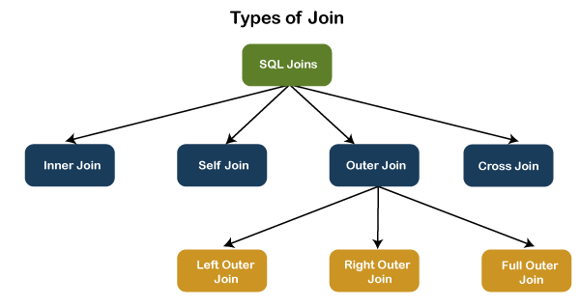
JOINING TABLE

Slide 4
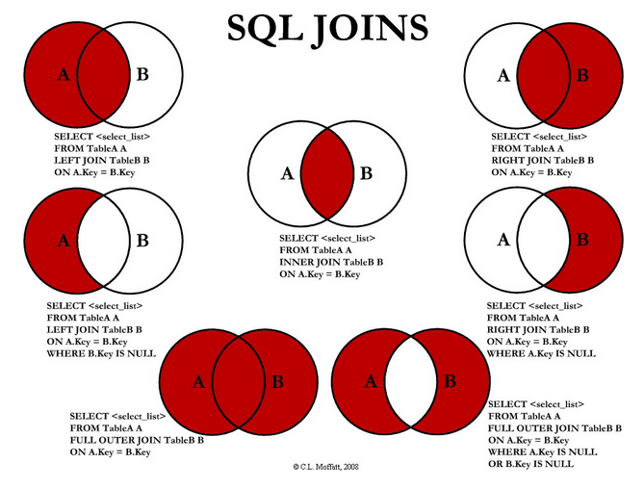
JOINING TABLE

Slide 5
JOINING TABLE

Slide 6
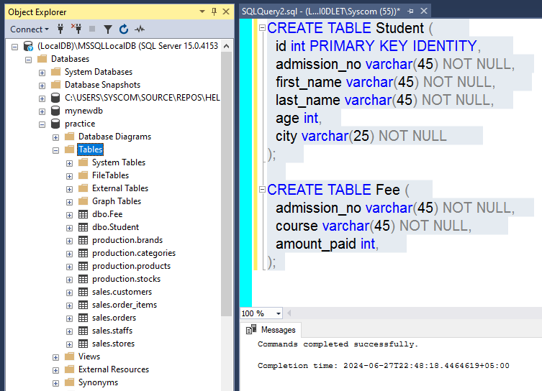
JOINING TABLE
Let us first create two tables "Student" and "Fee" using the following statement:
CREATE TABLE Student (
id int PRIMARY KEY IDENTITY,
admission_no varchar(45) NOT NULL,
first_name varchar(45) NOT NULL,
last_name varchar(45) NOT NULL,
age int,
city varchar(25) NOT NULL
);
CREATE TABLE Fee (
admission_no varchar(45) NOT NULL,
course varchar(45) NOT NULL,
amount_paid int,
);

Slide 7
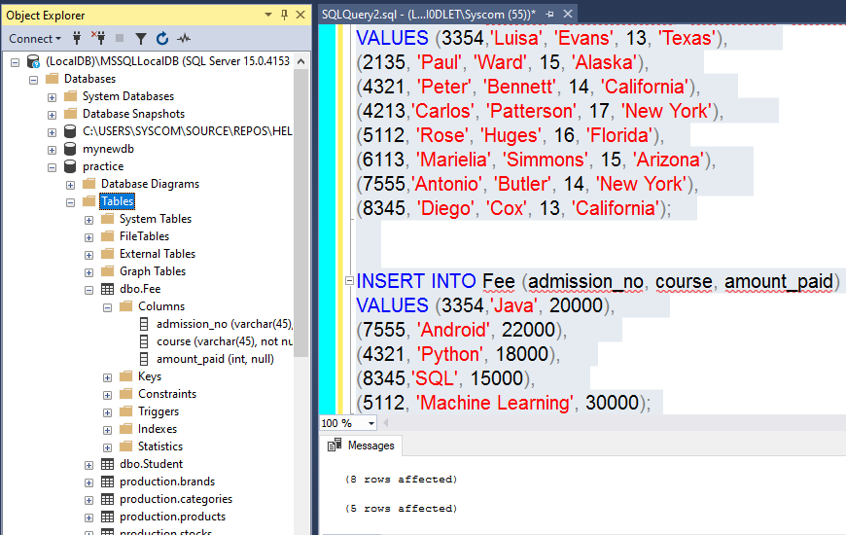
JOINING TABLE
we will insert some records into these tables using the below statements:
INSERT INTO Student (admission_no, first_name, last_name, age, city)
VALUES (3354,'Luisa', 'Evans', 13, 'Texas'),
(2135, 'Paul', 'Ward', 15, 'Alaska'),
(4321, 'Peter', 'Bennett', 14, 'California'),
(4213,'Carlos', 'Patterson', 17, 'New York'),
(5112, 'Rose', 'Huges', 16, 'Florida'),
(6113, 'Marielia', 'Simmons', 15, 'Arizona'),
(7555,'Antonio', 'Butler', 14, 'New York'),
(8345, 'Diego', 'Cox', 13, 'California');
INSERT INTO Fee (admission_no, course, amount_paid)
VALUES (3354,'Java', 20000),
(7555, 'Android', 22000),
(4321, 'Python', 18000),
(8345,'SQL', 15000),
(5112, 'Machine Learning', 30000);

Slide 8
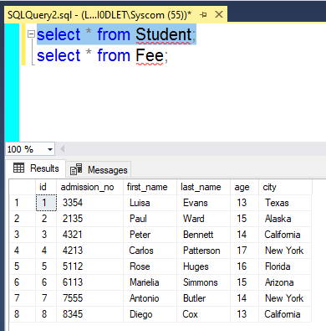
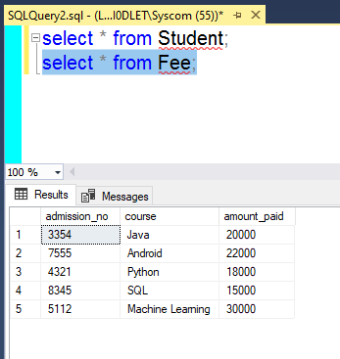
JOINING TABLE
Execute the SELECT statement to verify the records:

Slide 9
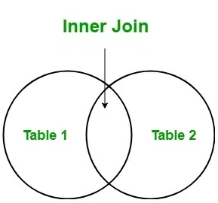
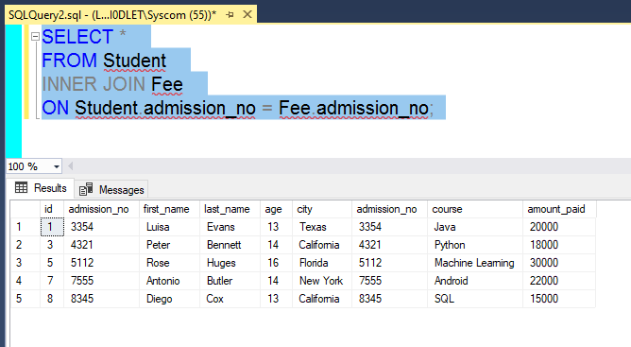
JOINING TABLE
Inner Join

Slide 10
JOINING TABLE
Inner Join

